Slide 1
Certification of Prevention Professionals

Slide 2
PSCBW BOARD MEMBERS
Gunthild Sondhi, CPP – Co-President
Pam Tindall, CPP – Co-President
Leanne Reid, CPP – Vice President
Jennifer Dorsett, CPP – Certification & Business Secretary
Kristi Sharpe, CPP – Treasurer
Liz Wilhelm, CPP
Margaret McCarthy, CPP
Sigrid Gauger, CPP
Joe Neigel, CPP
We need more Board members. Interested? Contact us! www.pscbw.com

Slide 3
VISION
To ensure an exemplary, professional substance abuse prevention workforce.
Upholding the standards of professionalism in substance use prevention since 2002
Notes:
3

Slide 4
MISSION
Uphold ethical standards
Certify substance use prevention professionals
Promote professional development & growth
Upholding the standards of professionalism in substance use prevention since 2002
Notes:
4

Slide 5
PSCBW STRUCTURE
*
*
Non-Profit, Peer-Led Volunteer Board
Member Board of the International Certification & Reciprocity Consortium
Tax-Exempt organization classified as a 501(c)(6) by the IRS, effective May 15, 2010
*
Upholding the standards of professionalism in substance use prevention since 2002
Notes:
5

Slide 6
TYPES OF CREDENTIALS
Internationally Certified Prevention Specialist (ICPS)
Also Known As
Certified Prevention Specialist | = | Certified Prevention Professional
PS |  | CPP
Upholding the standards of professionalism in substance use prevention since 2002
Notes:
6
Explain that the WA State CPP is portable to any other state that has a member board and is part of IC&RC. This means that if a person having a CPP wishes to work on Oregon, or Virginia for example, there is a very simple process to transfer that credential to another state. Also, there are several CPPs in WA state who transferred their credential from other states.

Slide 7
CPP/ICPS CERTIFICATION
Developed for Substance Use Prevention Professionals
Demonstrates mastery of the fundamental skills
Applicable across all practice settings
In general, it’s voluntary credentialing in Washington State
However, some employers require a CPP, such as the State of Washington’s Health Care Authority, Division of Behavioral Health and Recovery Services.
Upholding the standards of professionalism in substance use prevention since 2002
Notes:
7

Slide 8
OVERALL BENEFITS OF CERTIFICATION
Establishes professional standards
Attests to the individual’s knowledge & skills
Assists employers in identifying qualified practitioners
Upholding the standards of professionalism in substance use prevention since 2002
Notes:
8

Slide 9
BENEFITS FOR INDIVIDUALS
Sense of Pride & Accomplishment
Promotes continued professional development
Upholding the standards of professionalism in substance use prevention since 2002
Notes:
9

Slide 10
3
Steps to Credentialing
Submit completed candidate portfolio
Peer Review Process
Pass the online examination for the Substance Abuse Prevention Specialist
Upholding the standards of professionalism in substance use prevention since 2002
Notes:
10
Submit candidate portfolio
Complete a peer review process of their candidate portfolio
Successfully pass the written IC&RC International Certification Examination for Alcohol, Tobacco and Other Drug Abuse Prevention Specialists. The exam is computer-based, and applicants know immediately if they passed the test.
After passing the PS examination the PSCBW Board awards the credential at their next scheduled board meeting.

Slide 11
STEP 1: CANDIDATE PORTFOLIO
Applications may be submitted at any time.
The Application Portfolio includes:
Completed Application Checklist
Current criminal history background check
Signed Code of Ethical Conduct
Current certification fee
An application form documenting at minimum:
(1) 2000 hours of prevention-related experience
(2) 120 hours of supervised experience
(3) 120 clock hours of prevention education/training
Upholding the standards of professionalism in substance use prevention since 2002
Notes:
11

Slide 12
STEP 1: CANDIDATE PORTFOLIO
Verification of at least 2,000 hours of prevention-related experience.
A minimum of 50% of these hours must be alcohol, tobacco and other drug (ATOD) prevention-specific experience and must be completed in the last two years.
The balance may be hours in other types of general behavioral health prevention, such as suicide prevention, HIV prevention and bullying prevention.
Of the 2,000 required hours of prevention experience, a minimum of 120 hours of supervised experience must be in the six IC&RC domains (10 hours in each domain).
Upholding the standards of professionalism in substance use prevention since 2002
Notes:
12

Slide 13
6
STEP 1: CANDIDATE PORTFOLIO
IC&RC Prevention Domains
Planning & Evaluation
Prevention Education & Service Delivery
Communication
Community Organization
Public Policy & Environmental Change
Professional Growth & Responsibility
Upholding the standards of professionalism in substance use prevention since 2002
Notes:
13

Slide 14
STEP 1: CANDIDATE PORTFOLIO
Documentation of a minimum of 120 clock hours of prevention-specific education/training (Sixty of these hours must be earned within the last 10 years, with 40 of those 60 hours earned within the last two years.)
24 hours of Drug Education
45 hours of ATOD Prevention Education/Training
45 hours of General Prevention Education/Training
6 hours of prevention-specific Ethics Education/Training
Upholding the standards of professionalism in substance use prevention since 2002
Notes:
14

Slide 15
RECEIPT OF CANDIDATE PORTFOLIO
You will be notified when the PSCBW has received your portfolio.
Upholding the standards of professionalism in substance use prevention since 2002

Slide 16
STEP 2: PEER REVIEW
Eligibility Committee Review
Full Board Review
Once an application is reviewed and approved by PSCBW, a process which typically takes 1.5 - 2 months, PSCBW notifies the IC&RC that the applicant is approved for testing.
Upholding the standards of professionalism in substance use prevention since 2002
Notes:
16

Slide 17
STEP 2: COMPUTER-BASED EXAMINATION
PSCBW Testing Committee registers candidate for the exam with IC&RC.
Candidate receives an email with instructions from the testing company including testing dates & locations (typically at colleges throughout the State).
Candidate selects the date & location. Then registers for the exam.
The candidate must achieve a passing score on the computer-based International Certification & Reciprocity Consortium examination.
Upholding the standards of professionalism in substance use prevention since 2002
Notes:
17

Slide 18
STEP 3: NOTIFICATION
After the completion of the exam, the candidates will receive immediate notification of their test results.
Upholding the standards of professionalism in substance use prevention since 2002
Notes:
18

Slide 19
STEP 3: NOTIFICATION
For those awarded a CPP:
The credential effective date will be the date the candidate passes the examination.
It will remain in effect until the candidate’s birthday, two years after the year in which the credential was awarded.
Upholding the standards of professionalism in substance use prevention since 2002
Notes:
19

Slide 20
STEP 4: CPP RENEWAL
Documentation Requirements
40 hours of continuing education to be earned in two years
20 hours of general prevention education
Submit a current criminal history background check
20 hours of ATOD prevention education
Current renewal fee
Signed Code of Ethical Conduct
Upholding the standards of professionalism in substance use prevention since 2002
Notes:
20

Slide 21
CPP RECERTIFICATION
For former CPPs whose certification has lapsed and are now interested in regaining their CPP.
Documentation Requirements
40 hours of continuing education to be earned in two years
20 hours of general prevention education
Submit a current criminal history background check
20 hours of ATOD prevention education
Current renewal fee
Signed Code of Ethical Conduct
Upholding the standards of professionalism in substance use prevention since 2002
Notes:
21

Slide 22
MOVING INTO OR OUT OF WASHINGTON STATE?
CONTACT THE CERTIFICATION AGENCY IN THAT STATE
www.pscbw.com
SUBMIT
SUBMIT
SUBMIT
SUBMIT
Reciprocity Application Form
SUBMIT
SUBMIT
SUBMIT
SUBMIT
Documentation from Original Certifying State
SUBMIT
SUBMIT
SUBMIT
Processing Fee
SUBMIT
SUBMIT
SUBMIT
Recent Criminal Background Check
SUBMIT
SUBMIT
Signed Code of Ethical Conduct
Upholding the standards of professionalism in substance use prevention since 2002
Notes:
22

Slide 23
MULTI-TIERED PREVENTION SYSTEM
Advanced Level to Be Developed
Certified Prevention Professional (CPP)
Associate Prevention Professional (APP)
Upholding the standards of professionalism in substance use prevention since 2002
Notes:
23

Slide 24
ASSOCIATE PREVENTION PROFESSIONAL (APP)
Targeted toward students or beginning professionals who are learning prevention skills & entering the field
The APP requires less prevention-related experience and less ATOD training/education.
(1) 500 hours of prevention-related experience
(2) 70 clock hours of prevention education/training
50% (35 hours) must be earned within the last ten years, and 50% (35 hours) earned within the last two years
35 hours Drug Education and/or ATOD Prevention Education
35 hours General Prevention Education
Upholding the standards of professionalism in substance use prevention since 2002
Notes:
24

Slide 25
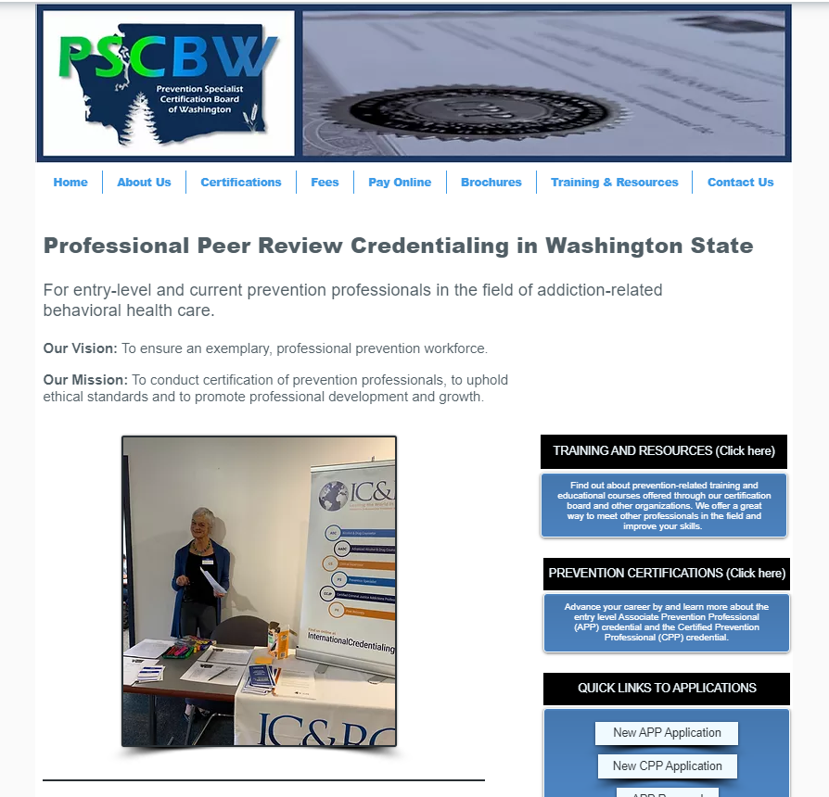
All Current Instructions, Applications & Fee Schedules for the CPP and APP Credentials Can Be Found on the PSCBW Website.
www.pscbw.com
Upholding the standards of professionalism in substance use prevention since 2002

Slide 26
CONTACT PSCBW FOR MORE INFORMATION:
MAILING ADDRESS:
PO Box 7172
Spokane, WA 99207-0172
WEBSITE:
www.pscbw.com
Upholding the standards of professionalism in substance use prevention since 2002
Notes:
26

