Slide 1

2
WELCOME
Obtaining and Maintaining Prevention Certification
January 21, 2026
2:00 PM – 3:00 PM

Slide 2

PSCBW Pilot Projects
CPP Renewal 3rd Year Upload Period

Slide 3
Gather all CEHs documents
90
45
Expiration Date
All CEHs documents due
Remaining documents due
No extensions granted

Slide 4
PSCBW Pilot Projects
Draft CPP Renewal CEHs Form

Slide 5
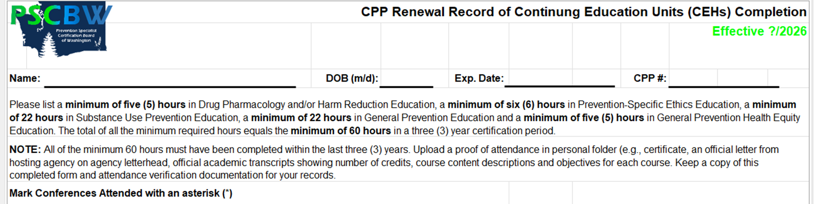
One Page CPP Renewal Record Form Draft

Slide 6
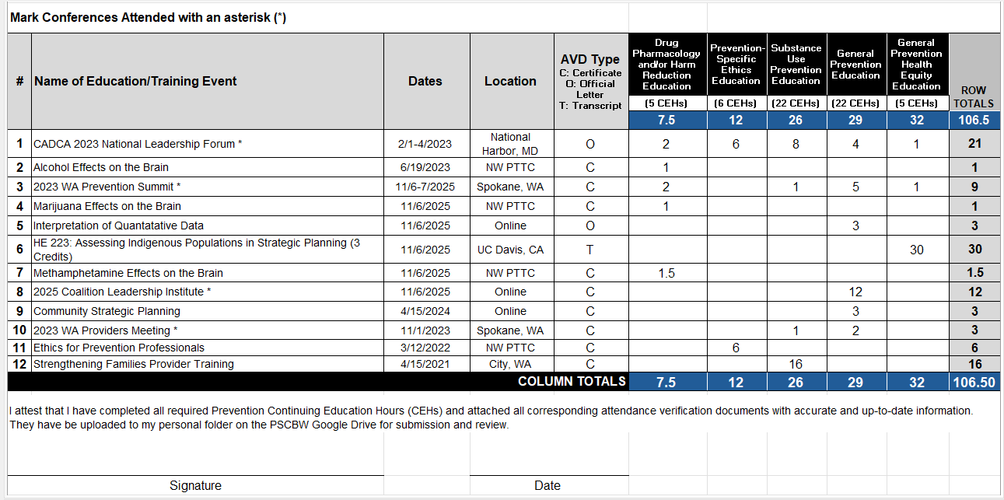

Slide 7
CPP Renewal Record of CEHs Completion Folder Contents
Current: |  | Revised:
 | Academic Transcripts |  | Academic Transcripts
 | Conferences Attended |  | Conferences Attended
 | Main Record of CEHs |  | Main Record of CEHs
 | Record Page 1 AVDs |  | Record AVDs (in numerical order)
 | Record Page 2 AVDs
 | Record Page 3 AVDs

Slide 8
PSCBW Pilot Projects
List of Acceptable CEHs by Category

Slide 9
Top 5 Trends During Application Reviews
What we are seeing.

Slide 10
Are instructions clear for how to upload documents and CEHs AVDs?

Slide 11
Please submit all documents in pdf format, not jpg.

Slide 12
Please scan supporting documentation and save in pdf format.

Slide 13


Upload all documents in their original mode.

Slide 14
It helps if CEHs attendance verification documents are uploaded in the order they are entered onto the Record Form.

Slide 15
Office Hours have now decreased to one/month. They will be held on the 3rd Wednesday of each month from 2-3 PM.
Register on our website: pscbw.com

Slide 16
1:1 session(s) for help during the testing process is by appointment only.

Slide 17
Getting involved with the Board

Slide 18

Thank you for attending our webinar today!
Questions?
How do we communicate during the review process with applicants that have summers off?

